Slide 1


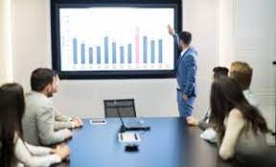
PYTHON PROJECT TCBDA14
TALYA DAVID 066092370
EINAT TEPPER 032291999
SIVAN LITVAK 065976029

Slide 2
The problem

Slide 3
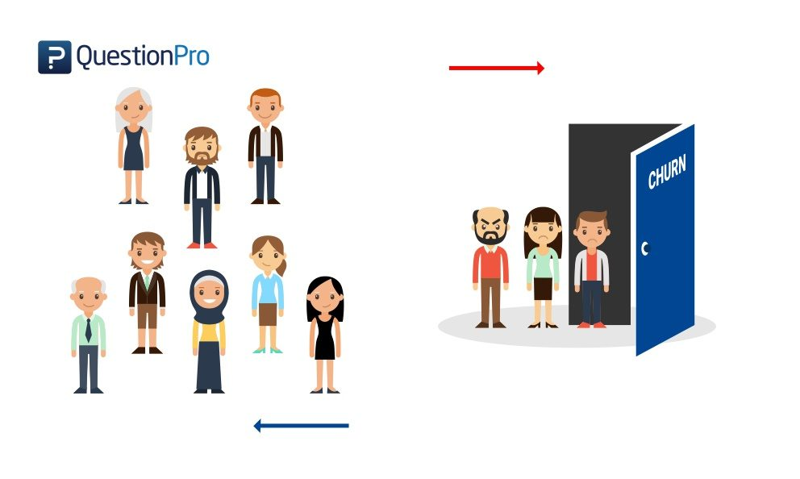
Churn prediction
In this project, we analyzed a set of data of a telecommunication services company, in order to predict whether a client will churn the company or retain.

Slide 4

The motivation to solve the problem
Churn prediction is critical for many businesses because acquiring new clients often costs more than retaining existing ones, and if limited in resources - where to invest the available funds in order to retain the majority of clients in the most efficient way

Slide 5
EDA
The process
Data preparation
Data cleaning
Feature engineering

Slide 6

The Dataset
7043 examples (rows)
21 columns
19 features
1 label (‘churn’)
11 missing values

Slide 7

The Data
Demographic- Gender, senior citizen, Partner, dependents.
Account info- contract type, Payment method, paperless billing, monthly charges, tenure.
The services provided info-
Phone services
Multiple lines
Internet Services
Online Security
Online Backup
Device Protection
Tech Support
Streaming TV
Streaming Movie
Churn info - Yes\ No.

Slide 8
Data preparation and cleaning
One-Hot-Encoding for categorical features.
Considering 'no internet service' etc as 'no'.
Imputing-
11 missing values of total charges replaced with new value: (monthly charge) x (tenure).
Adding new features-
Has triple : Yes\ No
Tenure group
new customers 0-3
regular customers 4-10
solid customers 11-72
Charges group
small charge <35
medium charger 36-90
expensive charge> 90

Slide 9
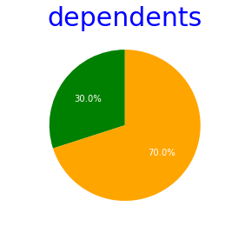
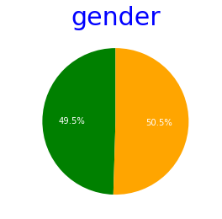
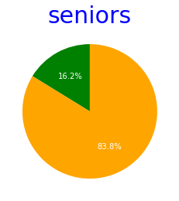
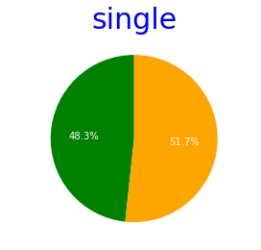
Our customers:
50% male
50% female
16% seniors
30% dependents
52% singles
48% partner

Slide 10
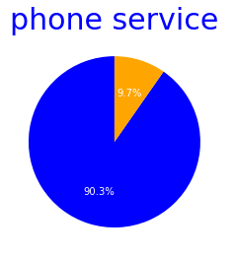
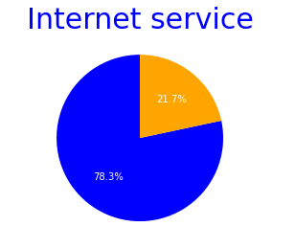
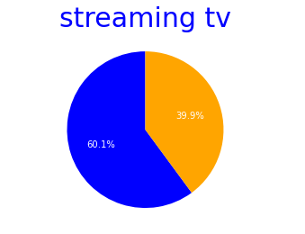
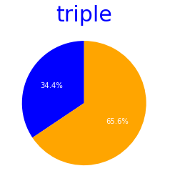
Our customers
by services:
90% phones service
78% internet service
60% streaming tv
34% triple

Slide 11
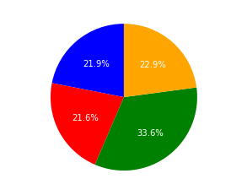
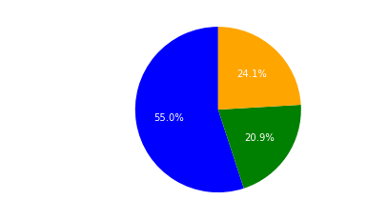
Payment method
Contract
33% of the customers are paying with electronic check.
55% of the customers have month to month contracts.

Slide 12
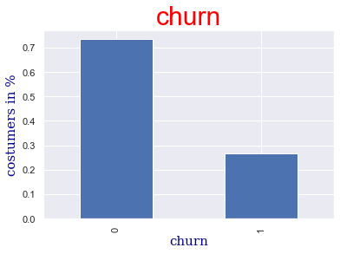
How many customers has churned—> 26.5%

Slide 13
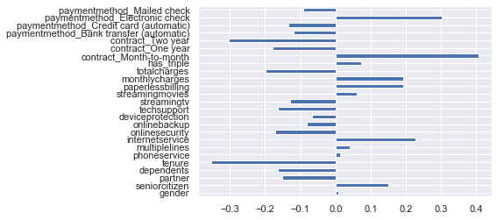
Correlation-
we checked the correlation between churn and our features(including the new features we have created).
The features with high correlation to churn are: tenure , contract, payment method ,total charges and monthly charges.

Slide 14
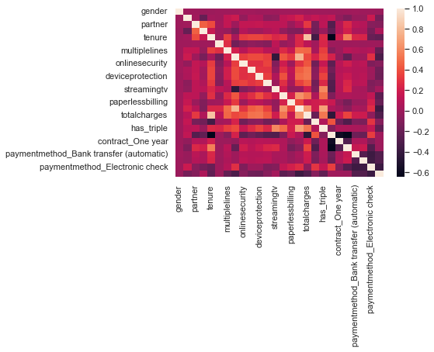
Correlation with Heatmap
The correlation Heatmap display uses different shades of red to visualized the strength of the correlation .
The shades are used to distinguish between positive/negative correlation.
brighter shades = positive correlation.
darker shades = negative correlation.

Slide 15
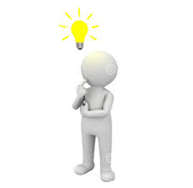
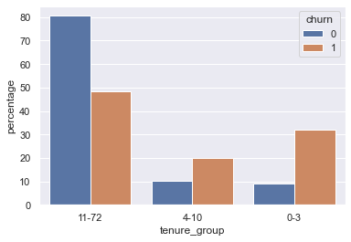
TENURE
There is a correlation between the feature “tenure” to the label “churn”:
New customers tend to churn more then others.
Tenurity greater than 10 years → less chance to churn.
High tenure = less chance to churn
Low tenure = higher chance to churn

Slide 16
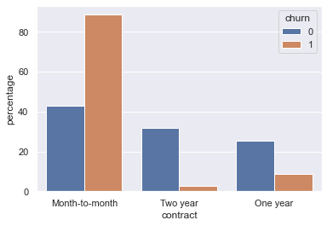
CONTRACT
There are 3 types of contracts. we examined the correlation between each type and churn → the longer the contract is the less chance to churn.
month to month contract → higher chance to churn.
long contract → less chance to churn

Slide 17
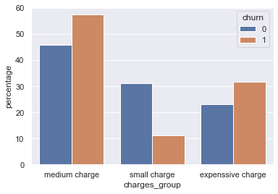
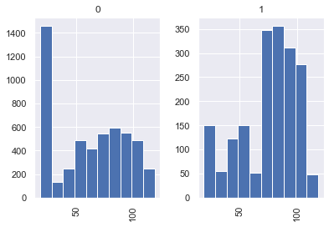
CHARGES
We created 3 groups, divided by monthly charges rate.
Small monthly charges → smallest chance to churn.
Expansive monthly charges → higher chance to churn.

Slide 18
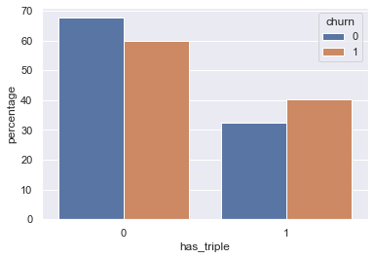
TRIPLE- Phone service+Internet service+Streaming TV
We created a new feature to examine if there is a correlation between customers who required triple to churn.
34% of the customers required triple.
26.5% of those customers has churned.
→ Customers who consume triple are more likely to churn.

Slide 19
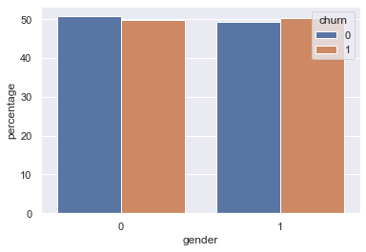
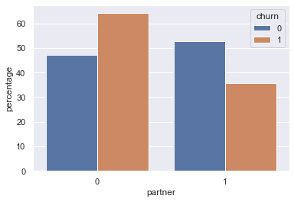
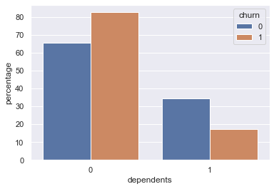
Gender:
Gender has no correlation with churn. This is why
we are ignoring this feature in our machine learning (ml) algorithms.
Clients has partners:
Customers without partners (single) are more likely to churn then customers with partners
Clients has dependents:
Customers with no dependents are more likely to churn.

Slide 20
MACHINE
LEARNING
ALGORITHMS

Slide 21
Train Test
80% percentage 20%
5634 examples 1409
In order to predict if a customer would churn or not, we splitted the data to 80% train model and 20% test model.There enough examples in the dataset in relation to the number of features, therefore we can not expect overfitting.
The algorithms we tried are:
Decision tree
Random forest algorithm.
KNN algorithm.

Slide 22
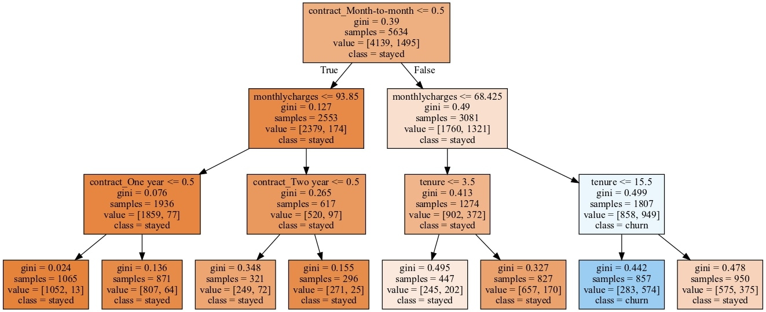
Decision tree
max depth=3 accuracy= 79.20%
max depth=4 accuracy= 79.34%
max depth=6 accuracy= 79.48%
Max depth of 6 is the best accuracy for decision tree!

Slide 23
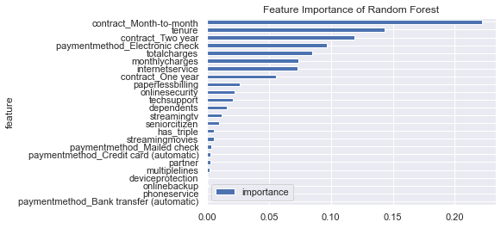
Random forest
max depth=4 accuracy= 78.99%
max depth=5 accuracy= 79.48%
max depth=6 accuracy= 81.40%
Max depth of 6 is the best accuracy for Random Forest!

Slide 24
KNN
Benchmark
k nearest neighbor
accuracy=74.44%
benchmark means to insert churn=0 (stayed) in the train and to see what the accuracy for this model.
accuracy=73.45%

Slide 25
Best performance model

Slide 26

RANDOM FOREST
Accuracy= 81.4%

Slide 27
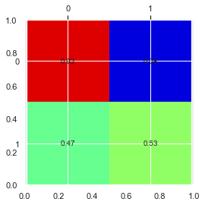
CONFUSION MATRIX
Confusion matrix demonstrates the model’s accuracy:
The model predicted:
92% of the staying customers
(it failed with 8% that were predicted as existing
customers although they churned), and -
53% of the churning customers (it failed with 47%
that were predicted as churn while they didn’t).
For small companies which don’t have the resources to invest in customer retention - confusion matrix can help aiming the resources to the most profitable customers - in this case - to focus on the 53% that the model has correctly predicted as churn.

Slide 28
Conclusions

Slide 29

Conclusions-
The company can now estimate whether a customer will churn or not, and concentrate its efforts on the predicted churning customers in order to preserve them (or not, as a function of the required resources in preserving them and the net gain from from such efforts.
Based on those predictions the company can build its strategic business plan diverting resources in the most efficient way

Slide 30
Thank you

